Slide 1


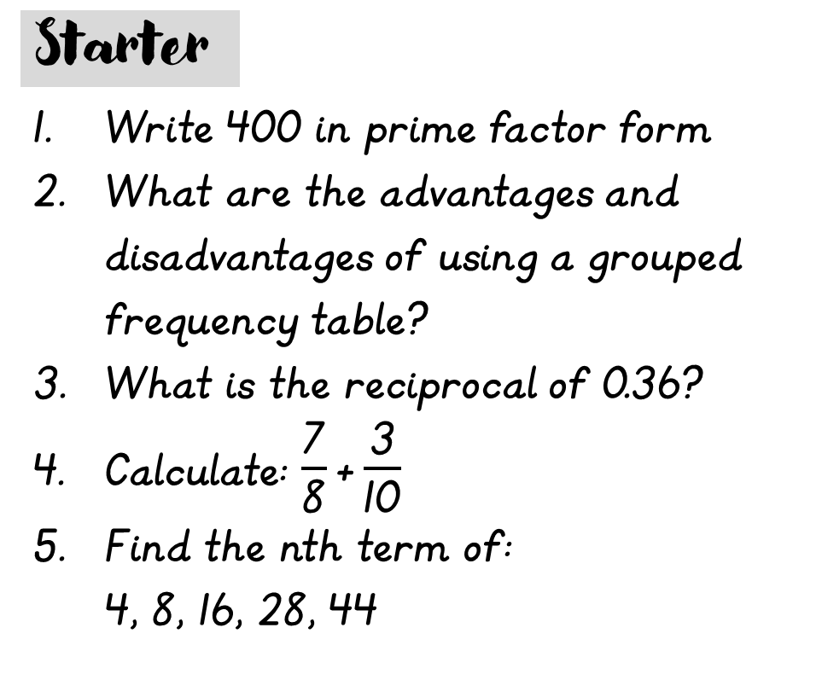
Monday, 7 September 2026
Percentages

Slide 2
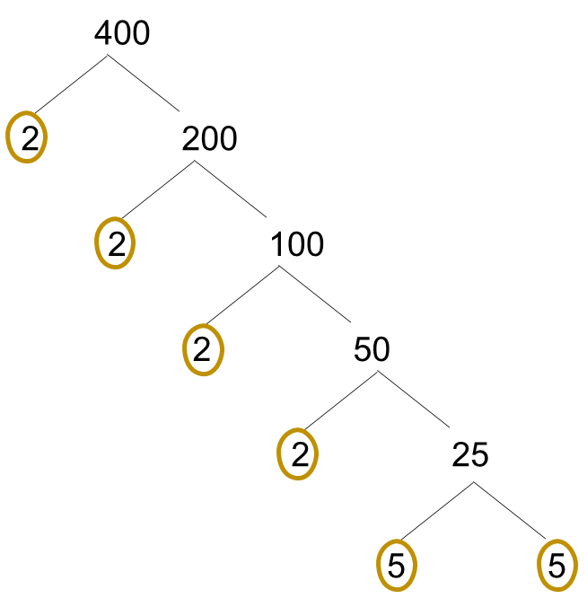






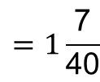




Advantages:
Compact and can be used to make estimations
Useful for large data sets
2.
Disadvantages:
Data not as useful as we are using intervals
Analysis is only an estimate so can give unreliable results
3.
an² + bn + c
0.36 = 36%
5.
2n²
36% = $\frac{\text{36}}{\text{100}}$
= $\frac{\text{9}}{\text{25}}$
2n² – 2n + 4
4 8 16 28 44
1.
reciprocal = $\frac{\text{25}}{\text{9}}$
+4
+8
+12
+16
halve
+4
+4
+4
n
1 2 3 4 5
4.
$$\frac{\text{7}}{\text{8}}+\frac{\text{3}}{\text{10}}=$$
2n²
2 8 18 32 50
nth term:
seq
4 8 16 28 44
-2n + 4
$$=\frac{\text{94}}{\text{80}}$$
$$=\frac{\text{47}}{\text{40}}$$
$$=1\frac{\text{7}}{\text{40}}$$
$$\frac{\text{70 + 24}}{\text{80}}$$
-
2 0 - 2 - 4 -6
400 = 2 x 2 x 2 x 2 x 5 x 5
400 = 2⁴ x 5²

Slide 3
6.
Reverse Percentages (Finding the original)
1.
Percentages of an Amount (calculator and non-calculator method)
5.
Percentage Change
Chapter 4 – Percentages
2.
Percentage Increase and Decrease
4.
Multipliers
3.
VAT, deposits & interest

Slide 4


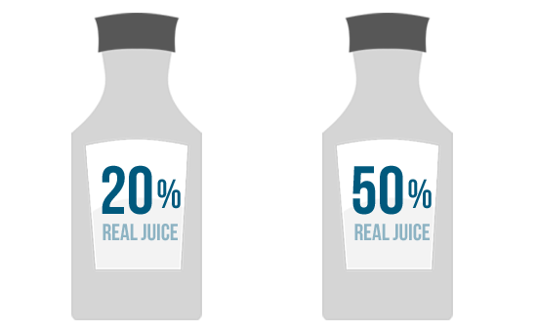
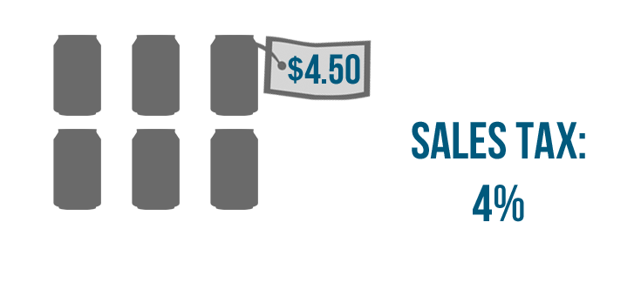

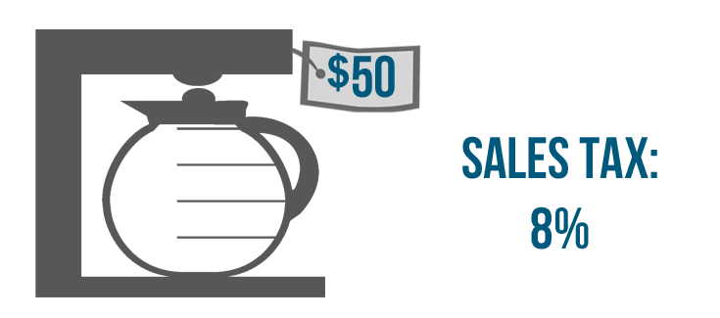
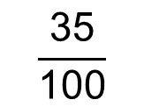
Per cent means ‘out of 100’
$$\frac{\text{35}}{\text{100}}$$
35% =

Slide 5
Percentages of Amounts

Slide 6




Find 10% by dividing by 10
e.g. Find 30% of 240g
e.g. Find 45% of 60g
e.g. Find 21% of 80g
10% = 6
10% = 8
10% = 24
x4
$÷$2
x2
$÷$10
x3
40% = 24
5% = 3
20% = 16
1% = 0.8
+
+
30% = 72
45% = 24 + 3
21% = 16 + 0.8
45% = 27
21% = 16.8

Slide 7


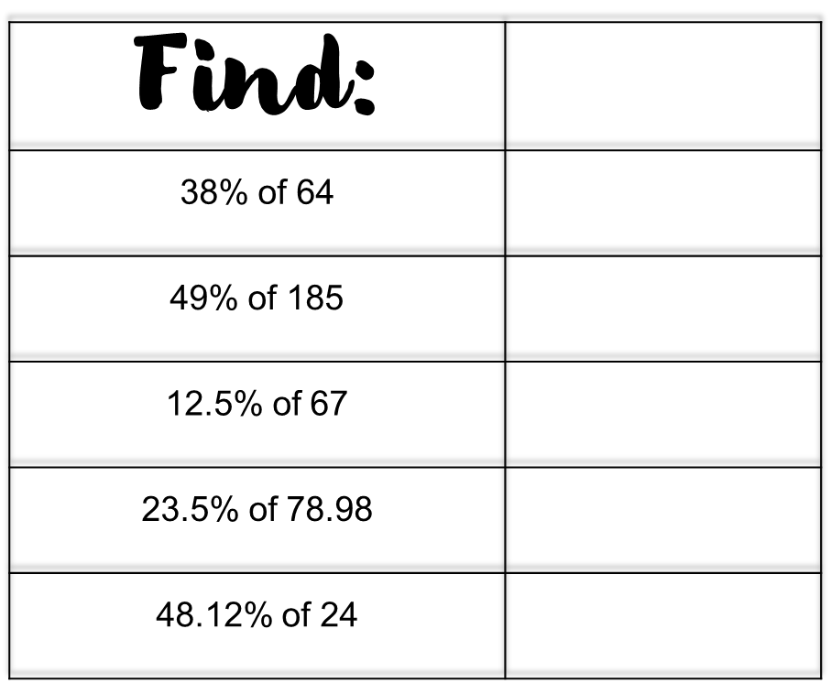
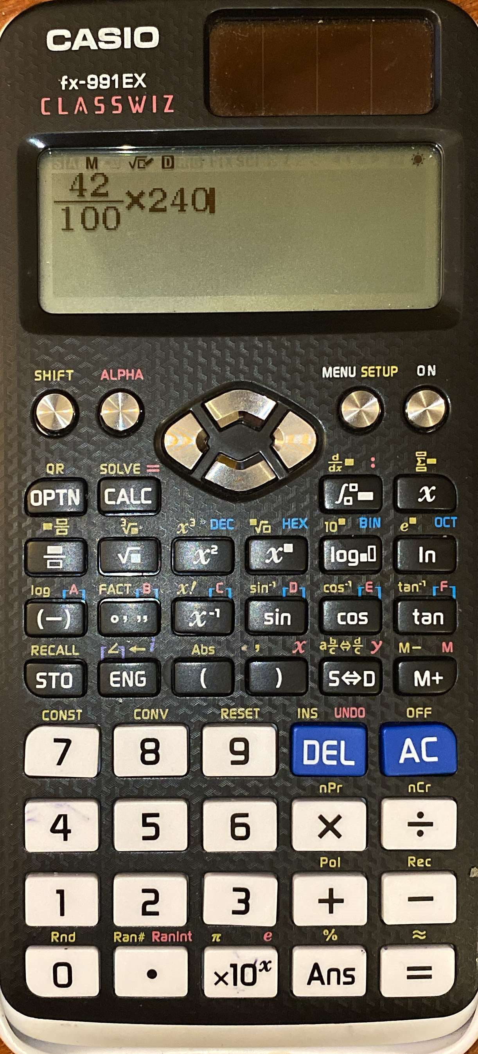
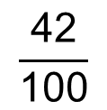
e.g. Find 42% of 240g
$$\frac{\text{42}}{\text{100}}$$
100.8
x
240
= 100.8
90.65
8.375
18.5603
11.5488

Slide 8


Slide 9


Percentage Increase/Decrease
Non-Calculator
E.g. Increase £300 by 35%
E.g. Decrease £240 by 12%
Step 1: Find 35% of £300
Step 1: Find 12% of £240
10% = 30
10% = 24
x3
$÷$2
$$÷10$$
30% = 90
5% = 15
1% = 2.4
35% = 90 + 15
= £105
x2
Step 2: Add £105 to £300
2% = 4.8
£300 + £105 = £405
12% = 24 + 4.8
= £28.8
Step 2: Subtract £28.80 from £240
£240 – £28.80 = £211.20

Slide 10
VAT and Interest

Slide 11

What is interest?
What is VAT?
Interest is money that is paid regularly at a particular percentage, usually when money has been lent or borrowed.
VAT stands for value added tax.
It is the tax you have to pay when you buy goods or services.
For example, a bank will give its customers interest to reward them for banking with them or saving money with them, but it will also charge interest to anyone who has borrowed money from them.
The standard rate of VAT in the UK is 20%
What is a deposit?
An amount payable as a first instalment on the purchase of something or as a pledge for a contract.
The balance is payable later.

Slide 12

Example:
Mr and Mrs MacDonald buy a new stereo. The price on the label is £300 plus 20% VAT. How much would Mr and Mrs MacDonald have to pay for the stereo?
Example:
Kate deposits £400 in to a bank account. She earns 5% simple interest per year. How much will be in her account after one year?
Find 20% of £300
Find 5% of £400
10% = £30
10% = £40
x2
$÷$2
20% = £60
5% = £20
Add £60 to £300
Add £20 to £400
£300 + £60 = £360
£400 + £20 = £420

Slide 13
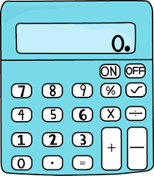

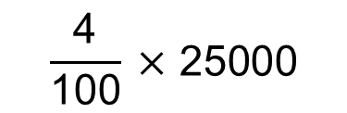

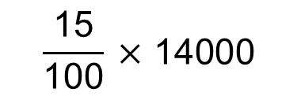


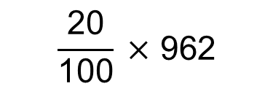


Question 1:
Sam’s salary is £25000 a year.
His salary increases by 4%.
Work out his new salary.
Question 2:
The value of a car depreciates by 15% each year. The value of a car when new is £14000. Work out the value of the car after 1 year
$$\frac{\text{4}}{\text{100}} \text{× 25000}$$
$$\frac{\text{15}}{\text{100}} \text{× 14000}$$
4% of £25000 =
= $\text{£1000}$
15% of £14000 =
= $\text{£2100}$
£25000 + $\text{£1000}$ = £26000
£14000 – $\text{£2100}$ = £11900
Question 3:
Hannah invests £3000. The interest rate is 5% per year. How much will be in her account at the end of 1 year?
Question 4:
A builders bill is £962 before VAT is added. VAT is charged at a rate of 20%. What will the bill be after VAT is added?
10% of £3000 = £300
$$\frac{\text{20}}{\text{100}} \text{× 962}$$
20% of £962 =
= $\text{£192.40}$
$÷$2
5% of £3000 = £150
£962 + £192.40 = £1154.40
£3000 + £150 = £3150

Slide 14


Slide 15

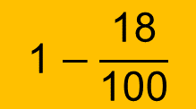
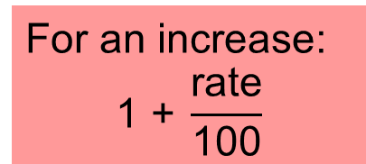
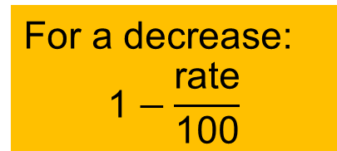
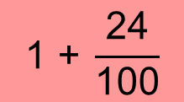
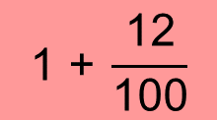
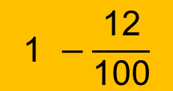
A multiplier is a single number that an amount is multiplied by in order to increase or decrease that amount.
For an increase:
$$\text{1 +} \frac{\text{rate}}{\text{100}}$$
For a decrease:
$$\text{1}−\frac{\text{rate}}{\text{100}}$$
Using a multiplier, increase £62 by 24%
$$\text{1 +} \frac{\text{24}}{\text{100}}$$
= 1.24
Find the multiplier that will increase £340 by 12%
62 x 1.24 = £76.88
$$\text{1 +} \frac{\text{12}}{\text{100}}$$
Using a multiplier, decrease £36 by 18%
= 1.12
$$\text{1}−\frac{\text{18}}{\text{100}}$$
Find the multiplier that will decrease £340 by 12%
= 0.82
36 x 0.82 = £29.52
$$\text{1 }−\frac{\text{12}}{\text{100}}$$
= 0.88

Slide 16
Write down the multiplier that can be used to work out an increase of :
a) 64% b) 3% c)13.4%
1.64
1.03
1.134
Write down the multiplier that can be used to work out a decrease of :
a) 7% b) 16% c) 5.6%
0.93
0.84
0.944

Slide 17


Slide 18
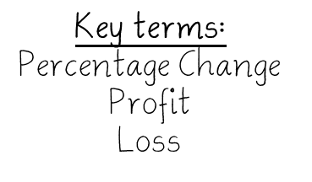

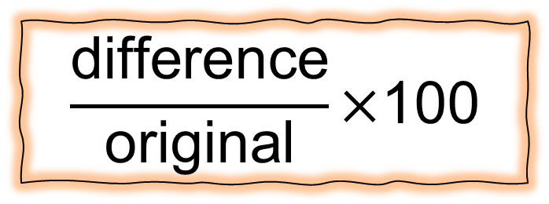
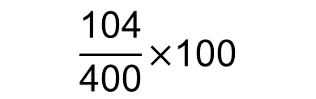
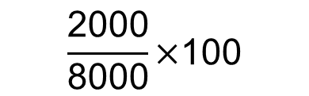
$$\frac{\text{difference}}{\text{original}}\text{×100}$$
Kate bought a car for £8000. One year later she sold it for £6000.
Work out her percentage loss.
Tony bought a box of 24 oranges for £4. He sold all the oranges for 21p.
Work out his percentage profit.
Difference: £8000 - £6000 = £2000
24 x 21p = 504p
£4 = 400p
$$\frac{\text{2000}}{\text{8000}}\text{×100}$$
504p – 400p = 104p
= 25%
$$\frac{\text{104}}{\text{400}}\text{×100}$$
= 26%

Slide 19
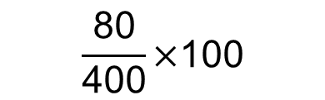
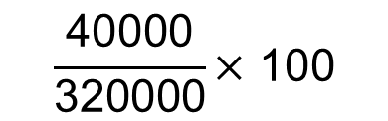
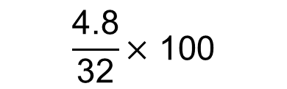
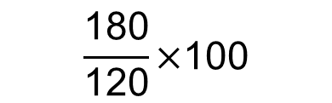
Question 1:
In 2010, a TV cost £400. In 2012, it is reduced to £320. Calculate the percentage loss.
Question 2:
A necklace costs £120. Due to popular demand, it increases in price to £300. Work out the percentage increase.
$$\frac{\text{80}}{\text{400}}\text{×100}$$
$$\frac{\text{180}}{\text{120}}\text{×100}$$
= 20%
= 150%
Question 3:
In a sale, the price of a clock is reduced from £32 to £27.20. Work out the percentage reduction.
Question 4:
Mr Smith buys a house for £320000. Five years later the value of the house has increased to £360000. Work out the percentage increase in the value of the house.
$$\frac{\text{4.8}}{\text{32}}\text{× 100}$$
$$\frac{\text{40000}}{\text{320000}}\text{× 100}$$
= 15%
= 12.5%

Slide 20
Reverse Percentage

Slide 21







A store is having a sale. All items are 20% off. A washing machine costs £420 in the sale. What was the original price?
A necklace increases by 15% due to popular demand. It now costs £230. What was the original price of the necklace?
Original = 100%
Original = 100%
Sale = 100% - 20%
= 80%
Sale = 100% + 15%
= 115%
£420 = 80%
£230 = 115%
$$\text{÷}\text{80}$$
$$\text{÷}\text{80}$$
$$\text{÷}\text{115}$$
$$\text{÷}\text{115}$$
£5.25
= 1%
£2
= 1%
x100
x100
x100
x100
£525
= 100%
£200
= 100%

Slide 22



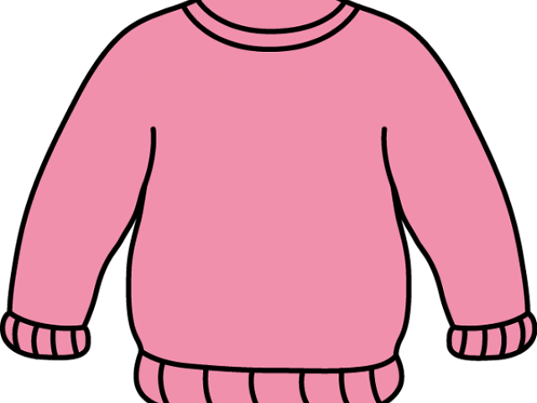












Question 1:
In a 35% off sale, a monitor costs £195. What was the original cost of the monitor?
Question 2:
After a 20% increase in price, a sofa costs £600. What was the original price?
Original = 100%
Sale = 65%
Original = 100%
New = 120%
£195 = 65%
£600 = 120%
$$\text{÷}\text{65}$$
$$\text{÷}\text{65}$$
$$\text{÷}\text{120}$$
$$\text{÷}\text{120}$$
£3
= 1%
£5
= 1%
x100
$$\text{x}\text{100}$$
x100
$$\text{x}\text{100}$$
£300
= 100%
£500
= 100%
Question 3:
In a 12% off sale, the price of a teddy bear is £44. What was the original?
Question 4:
In a 40% off sale, a jumper costs £39. What is the original cost of the jumper?
Original = 100%
Sale = 88%
Original = 100%
Sale = 60%
£44 = 88%
£39 = 60%
$$\text{÷}\text{88}$$
$$\text{÷}\text{88}$$
$$\text{÷}\text{88}$$
$$\text{÷}\text{88}$$
£0.50
= 1%
£0.65
= 1%
x100
$$\text{x}\text{100}$$
x100
$$\text{x}\text{100}$$
£50
= 100%
£65
= 100%

